Slide 1
Zigbee Sleepy End Device
2019 Jim Lin

Slide 2
Agenda
Basic concepts of sleepy end device
End Device and Sleepy End Device
Polling
Timeout and Keepalive
Finding and Binding
Step-by-Step hands-on: temperature sensor
Hands-on overview
Temperature sampling
Reporting
Finding and Binding
Sleep
Debug
Q & A

Slide 3
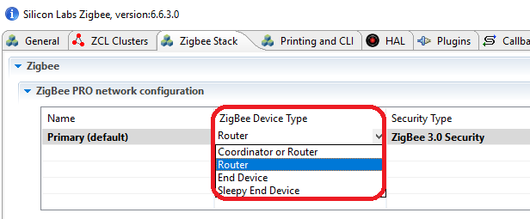
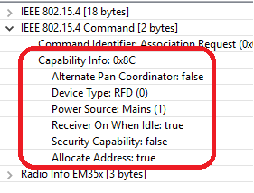
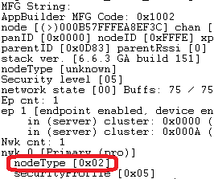
What are End Devices ?
End Device (ED)
Nodes on Zigbee network that don’t participate in routing
Communicate only through the parent node
Use data polling as keep-alive mechanism with parent
Rejoin to another router device when the parent is lost.
Able to receive messages at any time, not dependent on data polling
Sleepy End Device (SED)
A special category of end device that turns off the radio when idle
Parent node holds messages meant for the Sleepy end device
Polls the parent node periodically to receive incoming messages
No data is sent to SED unless it is requested by said device
1 – coordinator
2 – router
3 – end device
4 – sleepy end device
Notes:
In a Zigbee network, there are three types of devices:, Coordinators, routers and end devices. This training module focus on the end devices. If you are not familiar with the node types yet, please review the “Zigbee Introduction: Node Types, PAN IDs, Addresses” training module.
End devices are leaf nodes. They communicate only through their parent nodes and, unlike router devices, cannot relay messages intended for other nodes. They don’t participate in any routing. End devices rely on their parent routers to send and receive messages. End devices that do not have tight power consumption requirements may choose to have their radio on at all times. These end devices are known as RX-on-when-idle devices.
The Sleepy End Device is a special kind of end device, that turns off its radio when idle, which makes it a suitable choice for battery operated devices.

Slide 4
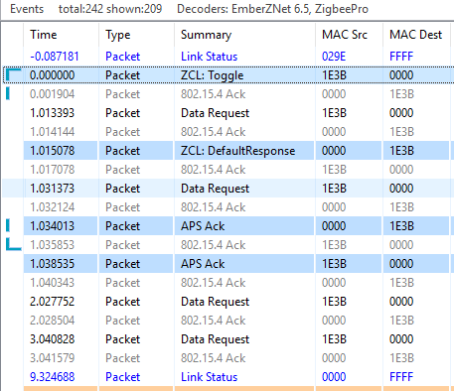
What is Polling?
The Main Function of Polling
keep-alive message between the child and parent
SED may use polling to request data from parent
Long Poll
The maximum amount of time an end device shall wait before polling its parent.
Short Poll
The amount of time that an end device may wait before polling its parent when it is in the process of sending or receiving a message.
Fast Polling
The state during which the stack actively polls its parent at the rate of short poll interval
Poll Control Cluster
Providing a mechanism for the management of an end device’s MAC Data Request rate
Short polling when sending and receiving a message
Notes:
Now that we are familiar with end-devices, lets talk about polling.
Polling is the event wherein an end device sends a “data request message” to its parent node.
Polling has 2 main purposes :
KEEP ALIVE : End devices poll their parent nodes periodically as a keep-alive mechanism to prevent being aged out of the network.
REQUEST MESSAGES: On the sleepy end device, polling is additionally used to request messages sent to it that are held by the parent node.
The Long Poll Interval represents the maximum amount of time between MAC Data Requests from the end device to its parent. When the device does not need to be responsive on the network, it polls its parent on the LONG_POLL interval.
The Short Poll Interval : When a device needs to be responsive to messages being sent to it from the network, it goes into a state where it polls its parent on the SHORT_POLL interval. This ensures that any messages received by its parent will immediately be retrieved by the sleepy end device and processed. The time during which the sleepy end device is polling at the SHORT_POLL interval is referred to as “Fast Polling mode”. When the device expects data (such as the zcl/zdo message responses, etc.), it enters fast polling mode. Sometimes a sleepy device needs to stay in fast poll mode while sending a complex series of messages that constitute a complete application level transaction with another device. The usage of this API is documented in app/framework/include/af.h.
The packet trace on the right was captured using the Silicon Labs Network Analyzer. It shows the end device polling its parent at the short poll interval(1 second) for 3 seconds (which is determined by Wake timeout) after sending a ZCL toggle command and expecting the default response.
Poll Control cluster provides a mechanism for the management of an end device’s data polling rate with ZCL command. the details of Poll Control cluster are discussed further in a separate training module (App Layer: Poll Control Cluster).

Slide 5
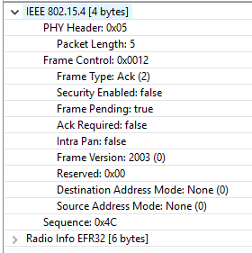
Polling as a means to request data from the parent
Used by Sleepy End Devices
Poll at least once within the EMBER_INDIRECT_TRANSMISSION_TIMEOUT to check for data at the parent to ensure receiving incoming messages reliably
Some sleepy end devices(example: sensors) are not expected to receive messages asynchronously. They just need to poll within the end device poll timeout
Sleepy End Device
Parent
Wake Up
Mac Data Poll
Mac Ack ( Pending data = False)
Back to sleep
Wake Up
Mac Data Poll
Mac Ack ( Pending data = TRUE)
Message
Mac Ack
Back to sleep
Notes:
Sleepy end devices do not receive data directly from other devices on the network. Instead, they must poll their parent for data and receive the data from their parent. The parent acts as a surrogate for the sleepy device, staying awake and buffering messages while the child sleeps.
The figure on the right illustrates the data polling process. Sleepy end devices wake up and poll their parents at regular intervals. The parent node uses the pending data flag in the MAC ACK to indicate that it has one or more messages waiting for the sleepy end device. If the pending data flag is true, the sleepy end device stays awake to receive the message(s) and acks them before going to sleep. If it is false, the sleepy end device is free to go back to sleep until the next poll attempt.
Please keep in mind that if you want the device to receive incoming messages and incoming APS ACKs (for its outgoing messages) reliably, you should poll at least once within the EMBER_INDIRECT_TRANSMISSION_TIMEOUT (7.68 seconds by default) to check for data at the parent because the length of time that the parent will hold on to a message is determined by this number. Some sleepy end devices(such as sensors) are not expected to asynchronously receive messages, so they don’t have the above limitation. They just need to poll within the end device poll timeout which we will talk about in the next slide.

Slide 6
Keepalive and timeout
All end devices MUST keepalive with their parents.
End Device
Parent
End device will move to a new parent if it loses the connection of the current parent .
Parent will remove the child when the child is not active.
Mac Data Poll(from unknown child)
Mac Ack
Leave Request(Rejoin = TRUE)
Mac Ack
Rejoin Request
When is a Rejoin initiated?
Parent initiates rejoin if it receives a mac data poll after the end device has been aged out of its child table
End device initiates a rejoin if its data polling message isn’t acknowledged by the parent over EMBER_AF_PLUGIN_END_DEVICE_SUPPORT_MAX_MISSED_POLLS tries.
Two keepalive mechanism
By polling
By timeout request/response message
Notes:
Mac Data Polling is used as the keep-alive message between the child and parent.
End devices have to poll their parent at least once within the End Device Poll Timeout (as set by EMBER_END_DEVICE_POLL_TIMEOUT or EZSP_CONFIG_END_DEVICE_POLL_TIMEOUT). Otherwise, these devices will be removed from the child table of the parent, effectively being aged out of the network. This is done to ensure that the child table slot is not permanently reserved for an end device that has been removed from the network ungracefully (i.e., if no Leave notification was heard from that device. Leave notifications are broadcasts and are not guaranteed to be received);
The parent node will ask the end device to leave and rejoin the network if it receives a mac data poll from the end device which doesn’t exist in the child table. The figure on the right illustrates the leave and rejoin process.
In addition to this, if the data polling message isn’t acknowledged by the parent for EMBER_AF_PLUGIN_END_DEVICE_SUPPORT_MAX_MISSED_POLLS times, the end device will attempt to rejoin the network to find a new parent.

Slide 7
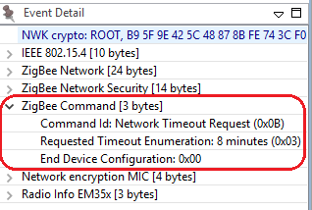
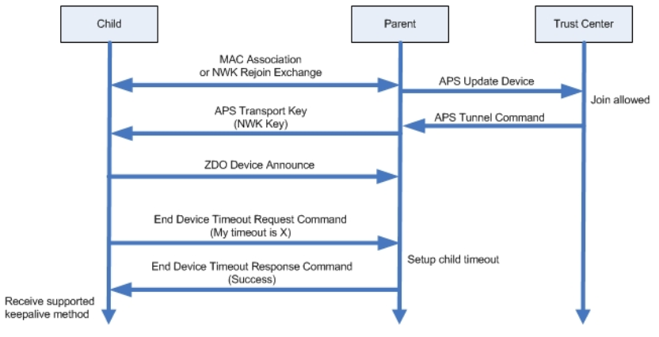
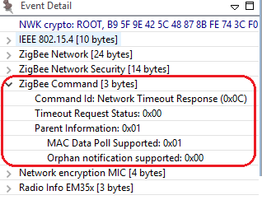
End Device Poll Timeout Negotiation
End Device Timeout Request Command
Notes:
Zigbee R21 Specification offers an end device timeout negotiation protocol and a standard way to implement child aging. The End Device Timeout Request command is sent by an end device to inform the parent of its timeout value when joining/rejoining the network. When the parent receives this command, it will update the End Device Timeout value for this end device locally and generate an end Device timeout response command with a status of SUCCESS. Pre-R21 devices do not support end device timeout command. So they can only use the default end device timeout value set initially on the parent node.

Slide 8
Application Design Considerations
End Device Configuration
End Device Support Plugin
Long poll interval
Short poll interval
Wake timeout
ZigBee PRO Leaf Library Plugin
End device poll timeout value
Parent Device Configuration
EMBER_INDIRECT_TRANSMISSION_TIMEOUT
ZigBee PRO Stack Library Plugin
End device poll timeout value
Notes:
While the end device polling is supported at the Zigbee networking layer, you do need additional application layer support to configure polling parameters. Ex: how often to poll the parent, etc.
We provide this through the End Device Support Plugin and ZigBee PRO Stack/Leaf Library.
As we discussed previously, the Long Poll Interval should be less than EMBER_INDIRECT_TRANSMISSION_TIMEOUT if you want the device to reliably receive incoming messages and incoming APS ACKs (for its outgoing messages). Long Poll Interval should also be less than End device poll timeout to avoid being aged out by the parent which results in unnecessary rejoins. Generally, the SHORT_POLL interval will be something less than/or equal to 1 second to ensure that all messages can be retrieved and processed by the sleepy end device immediately.
Wake timeout is the amount of time(3 seconds by default) that the device will stay in the fast poll mode if the task set in wake timeout bitmask is active. For example, if EMBER_AF_WAITING_FOR_ZCL_RESPONSE(0x00000010) is set in wake timeout bitmask, the sleepy end device will stay in short/fast poll mode for 3 seconds when waiting for the zcl response. For more information about the Application Task in bitmask, please refer to enum EmberAfApplicationTask defined in af-types.h
End device poll timeout can be set on both End device and parent device end. We will discuss on how to negotiate the End device poll timeout in the next slide.

Slide 9
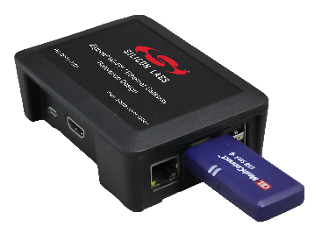


Hands-on: Overview
What’s the requirement for a sensor?
Temperature
Data sampling -- ADC
Reporting
Periodically
Report on change
Binding
Sleep
Notes:
While the end device polling is supported at the Zigbee networking layer, you do need additional application layer support to configure polling parameters. Ex: how often to poll the parent, etc.
We provide this through the End Device Support Plugin and ZigBee PRO Stack/Leaf Library.
As we discussed previously, the Long Poll Interval should be less than EMBER_INDIRECT_TRANSMISSION_TIMEOUT if you want the device to reliably receive incoming messages and incoming APS ACKs (for its outgoing messages). Long Poll Interval should also be less than End device poll timeout to avoid being aged out by the parent which results in unnecessary rejoins. Generally, the SHORT_POLL interval will be something less than/or equal to 1 second to ensure that all messages can be retrieved and processed by the sleepy end device immediately.
Wake timeout is the amount of time(3 seconds by default) that the device will stay in the fast poll mode if the task set in wake timeout bitmask is active. For example, if EMBER_AF_WAITING_FOR_ZCL_RESPONSE(0x00000010) is set in wake timeout bitmask, the sleepy end device will stay in short/fast poll mode for 3 seconds when waiting for the zcl response. For more information about the Application Task in bitmask, please refer to enum EmberAfApplicationTask defined in af-types.h
End device poll timeout can be set on both End device and parent device end. We will discuss on how to negotiate the End device poll timeout in the next slide.

Slide 10
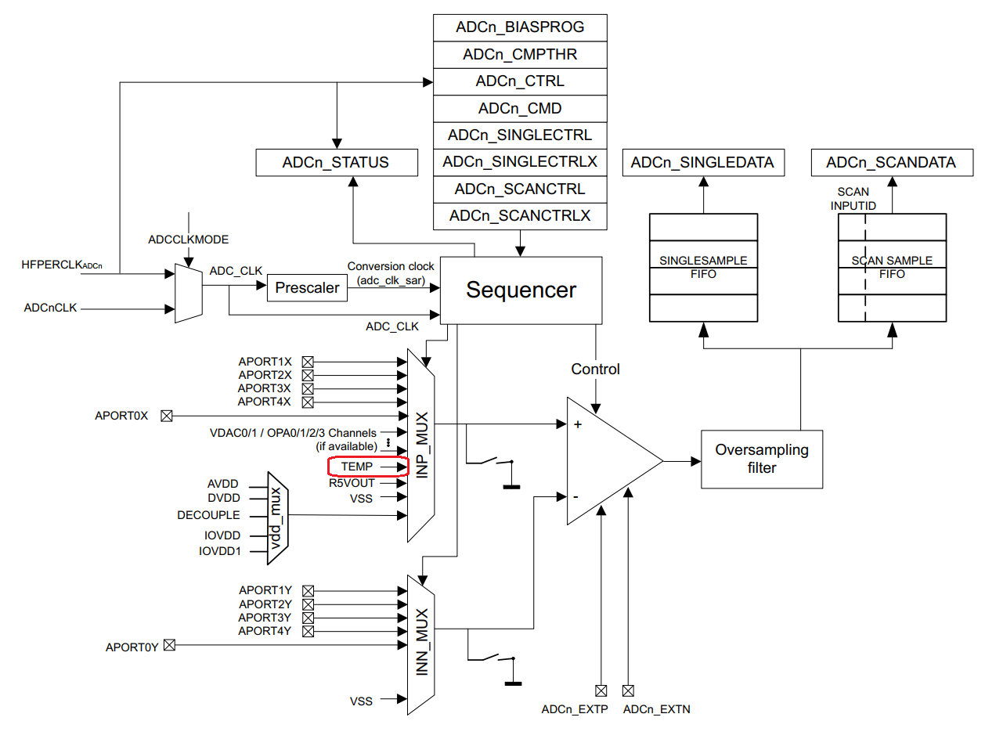
Hands-on: Data Sampling
EFR32xG12 Reference Manual
AN0021
Example:
app\mcu_example\SLSTK3402A_EFM32PG12\inttemp
Notes:
While the end device polling is supported at the Zigbee networking layer, you do need additional application layer support to configure polling parameters. Ex: how often to poll the parent, etc.
We provide this through the End Device Support Plugin and ZigBee PRO Stack/Leaf Library.
As we discussed previously, the Long Poll Interval should be less than EMBER_INDIRECT_TRANSMISSION_TIMEOUT if you want the device to reliably receive incoming messages and incoming APS ACKs (for its outgoing messages). Long Poll Interval should also be less than End device poll timeout to avoid being aged out by the parent which results in unnecessary rejoins. Generally, the SHORT_POLL interval will be something less than/or equal to 1 second to ensure that all messages can be retrieved and processed by the sleepy end device immediately.
Wake timeout is the amount of time(3 seconds by default) that the device will stay in the fast poll mode if the task set in wake timeout bitmask is active. For example, if EMBER_AF_WAITING_FOR_ZCL_RESPONSE(0x00000010) is set in wake timeout bitmask, the sleepy end device will stay in short/fast poll mode for 3 seconds when waiting for the zcl response. For more information about the Application Task in bitmask, please refer to enum EmberAfApplicationTask defined in af-types.h
End device poll timeout can be set on both End device and parent device end. We will discuss on how to negotiate the End device poll timeout in the next slide.

Slide 11
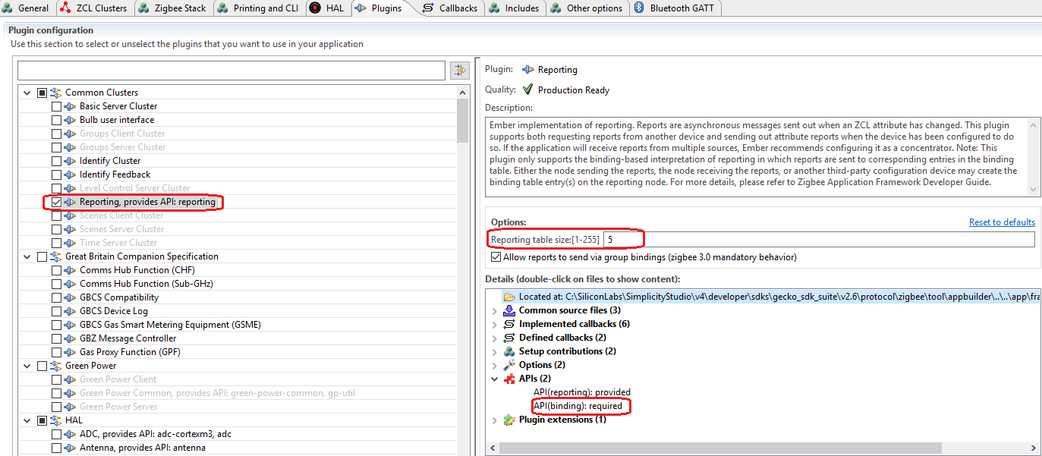
Hands-on: Reporting
Notes:
While the end device polling is supported at the Zigbee networking layer, you do need additional application layer support to configure polling parameters. Ex: how often to poll the parent, etc.
We provide this through the End Device Support Plugin and ZigBee PRO Stack/Leaf Library.
As we discussed previously, the Long Poll Interval should be less than EMBER_INDIRECT_TRANSMISSION_TIMEOUT if you want the device to reliably receive incoming messages and incoming APS ACKs (for its outgoing messages). Long Poll Interval should also be less than End device poll timeout to avoid being aged out by the parent which results in unnecessary rejoins. Generally, the SHORT_POLL interval will be something less than/or equal to 1 second to ensure that all messages can be retrieved and processed by the sleepy end device immediately.
Wake timeout is the amount of time(3 seconds by default) that the device will stay in the fast poll mode if the task set in wake timeout bitmask is active. For example, if EMBER_AF_WAITING_FOR_ZCL_RESPONSE(0x00000010) is set in wake timeout bitmask, the sleepy end device will stay in short/fast poll mode for 3 seconds when waiting for the zcl response. For more information about the Application Task in bitmask, please refer to enum EmberAfApplicationTask defined in af-types.h
End device poll timeout can be set on both End device and parent device end. We will discuss on how to negotiate the End device poll timeout in the next slide.

Slide 12
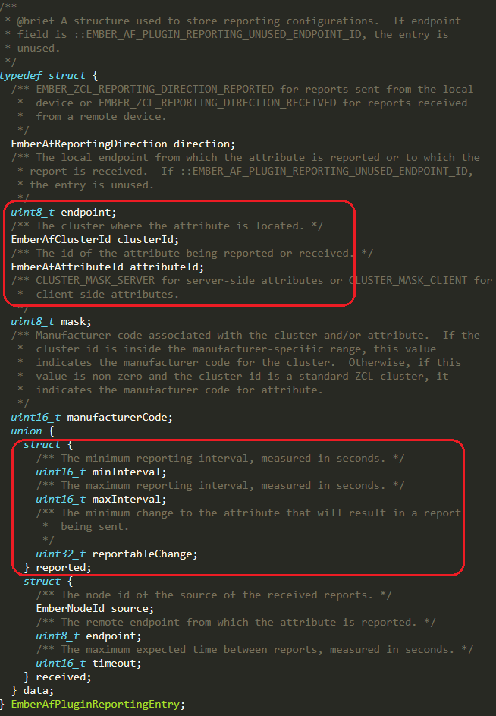
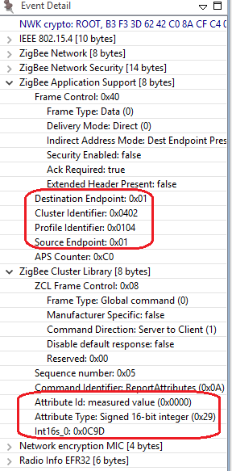
Hands-on: Reporting
Notes:
While the end device polling is supported at the Zigbee networking layer, you do need additional application layer support to configure polling parameters. Ex: how often to poll the parent, etc.
We provide this through the End Device Support Plugin and ZigBee PRO Stack/Leaf Library.
As we discussed previously, the Long Poll Interval should be less than EMBER_INDIRECT_TRANSMISSION_TIMEOUT if you want the device to reliably receive incoming messages and incoming APS ACKs (for its outgoing messages). Long Poll Interval should also be less than End device poll timeout to avoid being aged out by the parent which results in unnecessary rejoins. Generally, the SHORT_POLL interval will be something less than/or equal to 1 second to ensure that all messages can be retrieved and processed by the sleepy end device immediately.
Wake timeout is the amount of time(3 seconds by default) that the device will stay in the fast poll mode if the task set in wake timeout bitmask is active. For example, if EMBER_AF_WAITING_FOR_ZCL_RESPONSE(0x00000010) is set in wake timeout bitmask, the sleepy end device will stay in short/fast poll mode for 3 seconds when waiting for the zcl response. For more information about the Application Task in bitmask, please refer to enum EmberAfApplicationTask defined in af-types.h
End device poll timeout can be set on both End device and parent device end. We will discuss on how to negotiate the End device poll timeout in the next slide.

Slide 13
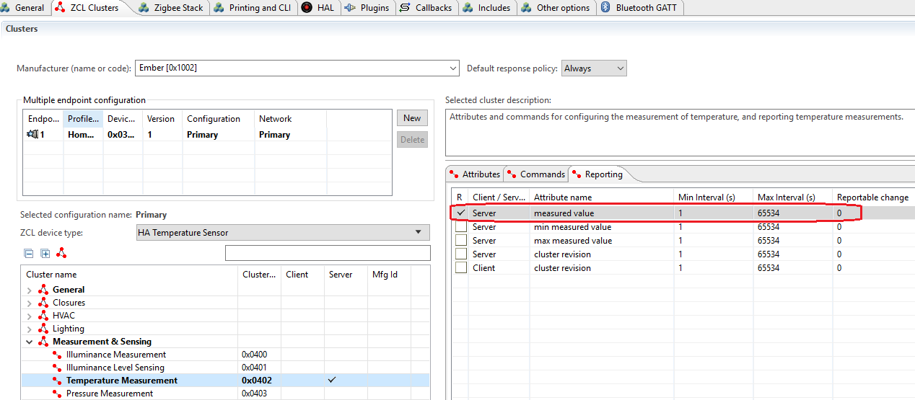
Hands-on: Reporting
Notes:
While the end device polling is supported at the Zigbee networking layer, you do need additional application layer support to configure polling parameters. Ex: how often to poll the parent, etc.
We provide this through the End Device Support Plugin and ZigBee PRO Stack/Leaf Library.
As we discussed previously, the Long Poll Interval should be less than EMBER_INDIRECT_TRANSMISSION_TIMEOUT if you want the device to reliably receive incoming messages and incoming APS ACKs (for its outgoing messages). Long Poll Interval should also be less than End device poll timeout to avoid being aged out by the parent which results in unnecessary rejoins. Generally, the SHORT_POLL interval will be something less than/or equal to 1 second to ensure that all messages can be retrieved and processed by the sleepy end device immediately.
Wake timeout is the amount of time(3 seconds by default) that the device will stay in the fast poll mode if the task set in wake timeout bitmask is active. For example, if EMBER_AF_WAITING_FOR_ZCL_RESPONSE(0x00000010) is set in wake timeout bitmask, the sleepy end device will stay in short/fast poll mode for 3 seconds when waiting for the zcl response. For more information about the Application Task in bitmask, please refer to enum EmberAfApplicationTask defined in af-types.h
End device poll timeout can be set on both End device and parent device end. We will discuss on how to negotiate the End device poll timeout in the next slide.

Slide 14
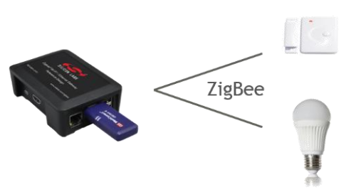
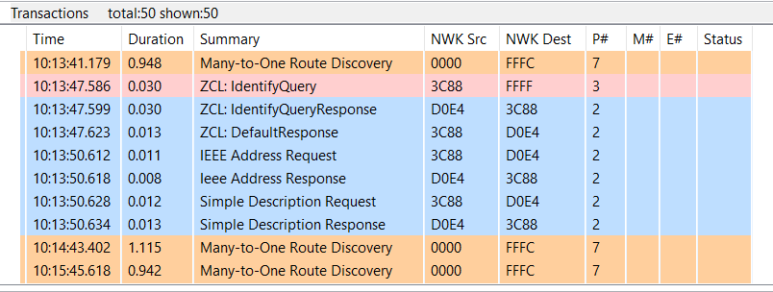
Debug Commands
Finding & Binding target
Finding & Binding initiator
Binding Table info
Z3LightSoc>plugin find-and-bind target 1
Find and Bind Target: Start target: 0x00
T00000000:RX len 3, ep FF, clus 0x0003 (Identify) FC 01 seq 00 cmd 01 payload[]
T00000000:RX len 5, ep 01, clus 0x0003 (Identify) FC 00 seq 00 cmd 0B payload[00 00]
Z3SwitchSoc>plugin find-and-bind initiator 1
Processing message: len=3 profile=0104 cluster=0003
T00000000:RX len 3, ep FF, clus 0x0003 (Identify) FC 01 seq 00 cmd 01 payload[]
Processing message: len=5 profile=0104 cluster=0003
T00000000:RX len 5, ep 01, clus 0x0003 (Identify) FC 09 seq 00 cmd 00 payload[72 00 ]
T00000000:TX (resp) Ucast 0x00 TX buffer: [00 00 0B 00 00 ]
Processing message: len=12 profile=0000 cluster=8001
Processing message: len=25 profile=0000 cluster=8004
Find and bind initiator complete: 0x00
Z3SwitchSoc>option binding-table print
# type nwk loc rem clus node eui
0: UNICA 0 0x01 0x01 0x0003 0xD0E4 (>)000B57FFFE648DA0
1: UNICA 0 0x01 0x01 0x0006 0xD0E4 (>)000B57FFFE648DA0
2: UNICA 0 0x01 0x01 0x0008 0xD0E4 (>)000B57FFFE648DA0
3 of 10 bindings used
Packet trace of Finding & Binding procedure
Notes:
It is easy to set up the testing for finding & binding with Z3LightSoc and Z3SwitchSoc samples.
First you can build the two samples directly, download the firmware to the kits separately, and then join to the same Z3.0 network formed by a Z3Gateway.
On the Z3LightSoc side, launch the console and type CLI command “plugin find-and-bind target 1”.
On the Z3SwitchSoc side, launch the console and type CLI command “plugin find-and-bind initiator 1”.
You will see the log “Find and bind initiator complete: 0x00” is printed on console after the finding & binding procedure finish. When you print the binding table on Z3SwitchSoc side(initiator), you will see the entries are created in binding table. All the matched clusters between initiator and target are bound. The finding & binding transactions can be found in packet trace, which proves the finding & binding working flow works as expected.
Let’s summarize how the finding and binding procedure works.
On the target side, it will write the identify time attribute for EMBER_AF_PLUGIN_FIND_AND_BIND_TARGET_COMMISSIONING_TIME. During the duration, the initiator broadcasts identify query and the target responds identify query response. Then the initiator sends IEEE address request to target to get the EUI64 of target, which will be used in creating binding table. The simple descriptor request will be sent to target to get the clusters info on target side. Once the clusters matched, the entries will be created in binding table of initiator.

Slide 15
Overview of Finding & Binding
Finding & Binding
Is a cluster commissioning method to establish application connection automatically
How to start
Invoked by user interaction on two or more devices
How to implement
Identifies and discovers end points using the Identify cluster
What’s the result
Binding is created at the initiator
Notes:
As we know, a switch always binds to a light in Smart Home user case. Is there any easy way to implement it? The answer is yes, finding & binding can be used here.
Let’s look at the overview of Finding & Binding, first, it is a cluster commissioning method to establish application connection automatically, which can be invoked by user interaction on two or more endpoints on two or more nodes. This method identifies and discovers endpoints using the Identify cluster. For each match between corresponding application clusters on the endpoints, binding is created at the initiator of the application transaction.
For example, both the switch and light have on-off cluster, the binding for on-off cluster will be created after the finding & binding operations on both sides.
Next, we will talk about how the finding & binding works and introduce the detailed procedures on target and initiator.
At last, we will introduce how to test the finding and binding with Z3LighstSoc and Z3SwitchSoc sample code.

Slide 16
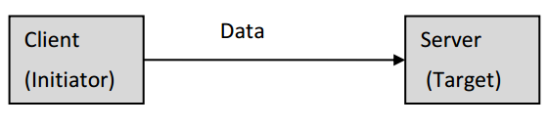
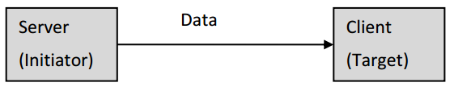
Which device needs perform Finding & Binding
The application SHALL perform finding & binding as an initiator endpoint
Type 1 client cluster
Type 2 server cluster
The application SHALL perform finding & binding as a target endpoint
Type 1 server cluster
Type 2 client cluster
Device 1
Device 2
Type 1 cluster
Type 2 cluster
Notes:
As we know, there are two kinds of clusters: Type 1 and Type 2.
A application cluster is either a Type 1 or Type 2 cluster, depends on its primary functional transactions. A transaction has an initiator and a target.
A type 1 cluster’s primary function is to initiate transactions from the client to the server. For example: An On/Off client sends commands (data) to the On/Off server.
A type 2 cluster’s primary function is to initiate transactions from the server to the client. For example: An Temperature Measurement server reports to the Temperature Measurement client.
For a type 1 client or a type 2 server cluster, the application shall perform finding & binding as an initiator endpoint.
For a type 1 server or type 2 client cluster, the application shall perform finding & binding as a target endpoint.

Slide 17
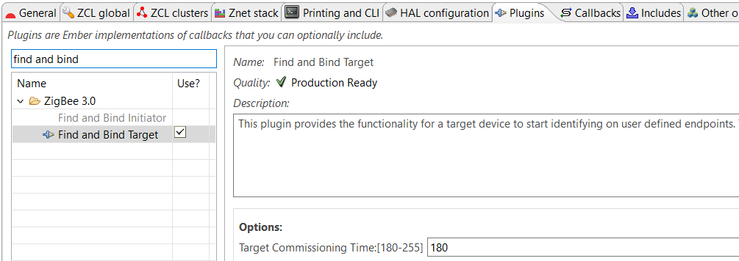
Finding & Binding procedure for a target endpoint
Finding & Binding target
Write identify time attribute
Handle identify query requests from the initiator
Plugin in Appbuilder
Initiator
Target
Target
Find and Bind target start
Find and Bind start
Broadcast Identify Query (0xFFFF)
Identify Query Response
IEEE Address Request
IEEE Address Response
Simple Descriptor Request
Simple Descriptor Response
Clusters matched
Create entry in binding table
Notes:
Please look at the right graph, which shows the working flow of the finding & binding procedure. We will talk about the target side firstly.
On the finding & binding target endpoint, once the finding & binding target start, it will write the identify time attribute firstly to make sure the target can be identified. In Appbuilder, the identify time can be configurated in “Find and Bind Target” plugin and the default value is 180 seconds. During the identify time, the target should respond to the identify query from initiator. Once the decrementing identify time attribute reaches zero, the target shall terminate the finding & binding procedure.
It means that the finding & binding target should write identify time attribute to make sure it can be identified during the finding & binding procedure.

Slide 18
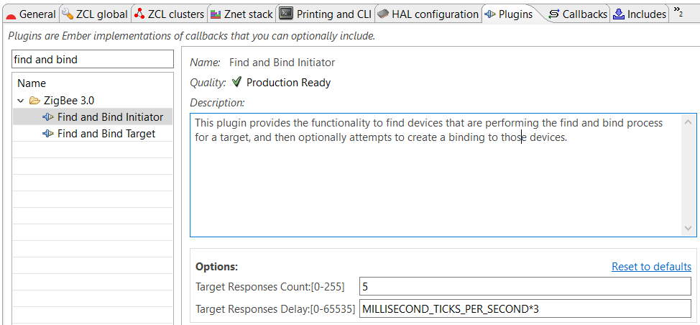
Finding & binding procedure for an initiator endpoint
Finding & Binding initiator
Broadcast identify query
Identify query responses received
Send simple descriptor request
Binding table is created for matched clusters
Plugin in Appbuilder
Initiator
Target
Initiator
Find and Bind target start
Find and Bind start
Broadcast Identify Query (0xFFFF)
Identify Query Response
IEEE Address Request
IEEE Address Response
Simple Descriptor Request
Simple Descriptor Response
Clusters matched
Create entry in binding table
Notes:
On the finding & binding Initiator endpoint, it broadcasts identify query to all nodes which include sleepy end device(using the broadcast address 0xffff). If no identify query response commands received, the initiator sets status to NO_IDENTIFY_QUERY_RESPONSE and terminates the finding & binding procedure.
If at least one identify query response is received, the initiator sends IEEE address request to get the EUI64 of the target, which will be used for binding table entry later. And then the initiator sends simple descriptor request to get the clusters info on target. Once some clusters matched between initiator and target endpoints, then the binding is created for every matched clusters on initiator. If a group binding is requested, the initiator endpoint configures group membership of the target endpoint, which means that the initiator unicasts “add group” command to the target.
In Appbuilder, there are two options can be configured in “Find and Bind Initiator” plugin. The “Target Responses Count” means the number of the target responses that the initiator will accept. The “Target Responses Delay” means how long the initiator will listen for target responses. You can feel free to configure these options to fit your user case.

Slide 19
The APIs to start finding & binding operations
Start target finding and binding operations
EmberAfStatus emberAfPluginFindAndBindTargetStart(uint8_t endpoint)
In find-and-bind-target.h
Start initiator finding and binding operations
EmberStatus emberAfPluginFindAndBindInitiatorStart(uint8_t endpoint)
In find-and-bind-initiator.h
Notes:
You may want to know what are the APIs to start finding & binding operations.
The API to start target finding and binding operations is emberAfPluginFindAndBindTargetStart(), which can be found in find-and-bind-target.h. It is a call to this function will commence the target finding and binding operations. Specifically, the target will attempt to start identifying on the endpoint that is passed as a parameter. The EmberAfStatus value describing the success of the commencement of the target operations.
As the similar, the API to start initiator finding and binding operations is emberAfPluginFindAndBindInitiatorStart(), which can be found in find-and-bind-initiator.h. It is a call to this function will commence the initiator finding and binding operations. Specifically, the initiator will attempt to start searching for potential bindings that can be made with identifying targets. The EmberStatus value describing the success of the commencement of the initiator operations.
Please note that, the target should be started first during the finding & binding procedure.

Slide 20
Debug Commands
Finding & Binding target
Finding & Binding initiator
Binding Table info
Z3LightSoc>plugin find-and-bind target 1
Find and Bind Target: Start target: 0x00
T00000000:RX len 3, ep FF, clus 0x0003 (Identify) FC 01 seq 00 cmd 01 payload[]
T00000000:RX len 5, ep 01, clus 0x0003 (Identify) FC 00 seq 00 cmd 0B payload[00 00]
Z3SwitchSoc>plugin find-and-bind initiator 1
Processing message: len=3 profile=0104 cluster=0003
T00000000:RX len 3, ep FF, clus 0x0003 (Identify) FC 01 seq 00 cmd 01 payload[]
Processing message: len=5 profile=0104 cluster=0003
T00000000:RX len 5, ep 01, clus 0x0003 (Identify) FC 09 seq 00 cmd 00 payload[72 00 ]
T00000000:TX (resp) Ucast 0x00 TX buffer: [00 00 0B 00 00 ]
Processing message: len=12 profile=0000 cluster=8001
Processing message: len=25 profile=0000 cluster=8004
Find and bind initiator complete: 0x00
Z3SwitchSoc>option binding-table print
# type nwk loc rem clus node eui
0: UNICA 0 0x01 0x01 0x0003 0xD0E4 (>)000B57FFFE648DA0
1: UNICA 0 0x01 0x01 0x0006 0xD0E4 (>)000B57FFFE648DA0
2: UNICA 0 0x01 0x01 0x0008 0xD0E4 (>)000B57FFFE648DA0
3 of 10 bindings used
Packet trace of Finding & Binding procedure
Notes:
It is easy to set up the testing for finding & binding with Z3LightSoc and Z3SwitchSoc samples.
First you can build the two samples directly, download the firmware to the kits separately, and then join to the same Z3.0 network formed by a Z3Gateway.
On the Z3LightSoc side, launch the console and type CLI command “plugin find-and-bind target 1”.
On the Z3SwitchSoc side, launch the console and type CLI command “plugin find-and-bind initiator 1”.
You will see the log “Find and bind initiator complete: 0x00” is printed on console after the finding & binding procedure finish. When you print the binding table on Z3SwitchSoc side(initiator), you will see the entries are created in binding table. All the matched clusters between initiator and target are bound. The finding & binding transactions can be found in packet trace, which proves the finding & binding working flow works as expected.
Let’s summarize how the finding and binding procedure works.
On the target side, it will write the identify time attribute for EMBER_AF_PLUGIN_FIND_AND_BIND_TARGET_COMMISSIONING_TIME. During the duration, the initiator broadcasts identify query and the target responds identify query response. Then the initiator sends IEEE address request to target to get the EUI64 of target, which will be used in creating binding table. The simple descriptor request will be sent to target to get the clusters info on target side. Once the clusters matched, the entries will be created in binding table of initiator.

Slide 21
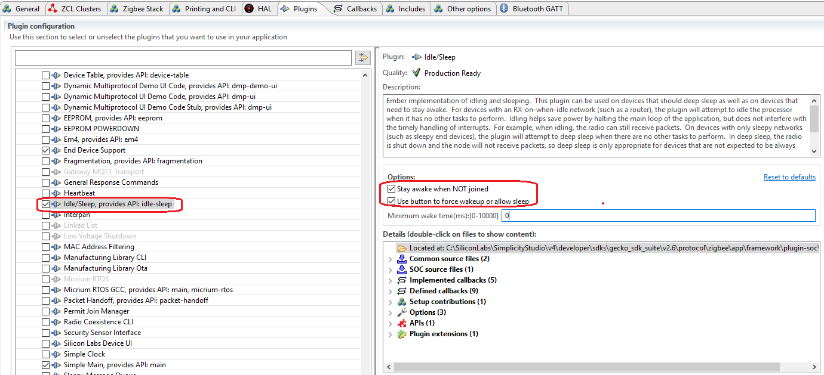
Sleeping
Press button0 to force device to stay awake
Press button1 to allow device to sleep
Notes:
You may want to know what are the APIs to start finding & binding operations.
The API to start target finding and binding operations is emberAfPluginFindAndBindTargetStart(), which can be found in find-and-bind-target.h. It is a call to this function will commence the target finding and binding operations. Specifically, the target will attempt to start identifying on the endpoint that is passed as a parameter. The EmberAfStatus value describing the success of the commencement of the target operations.
As the similar, the API to start initiator finding and binding operations is emberAfPluginFindAndBindInitiatorStart(), which can be found in find-and-bind-initiator.h. It is a call to this function will commence the initiator finding and binding operations. Specifically, the initiator will attempt to start searching for potential bindings that can be made with identifying targets. The EmberStatus value describing the success of the commencement of the initiator operations.
Please note that, the target should be started first during the finding & binding procedure.

Slide 22
Q&A
Q&A

Slide 23
Thank you!
Notes:
Thanks

